Slide 1


Slide 2
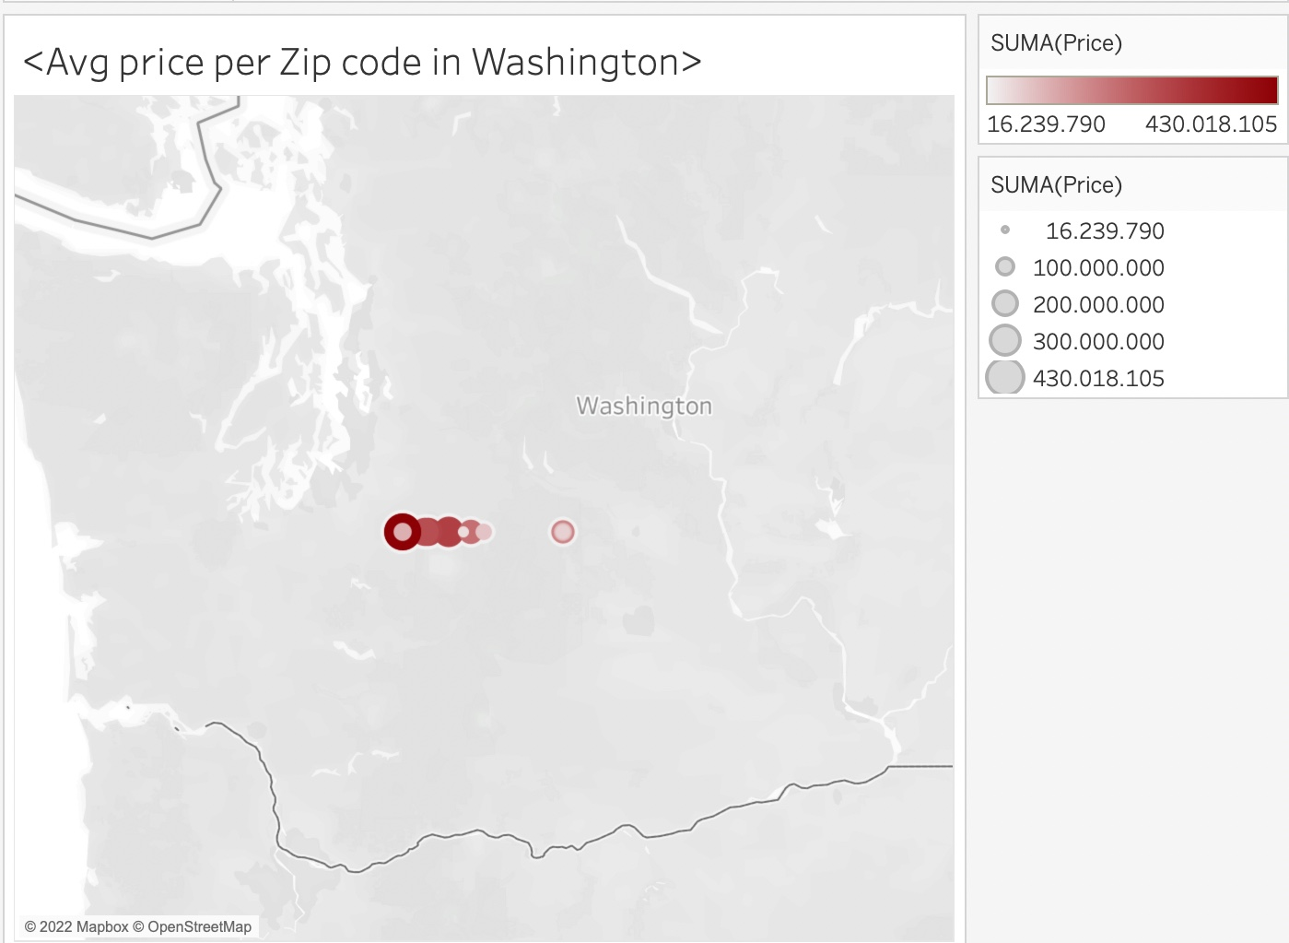
LOCATION OF OUR PROPERTIES
TOTAL PROPERTIES:
21.596
HERITAGE VALUE: 116.685.631.98$
AVG PRICE OF PROPERTIES: 540.311,32$

Slide 3
GOALS
INCREASE Nª OF TRANSACTIONS
INCREASE MEDIAN HOME PRICE
INCREASE NET REVENUE
INCREASE ANNUAL PROFIT

Slide 4
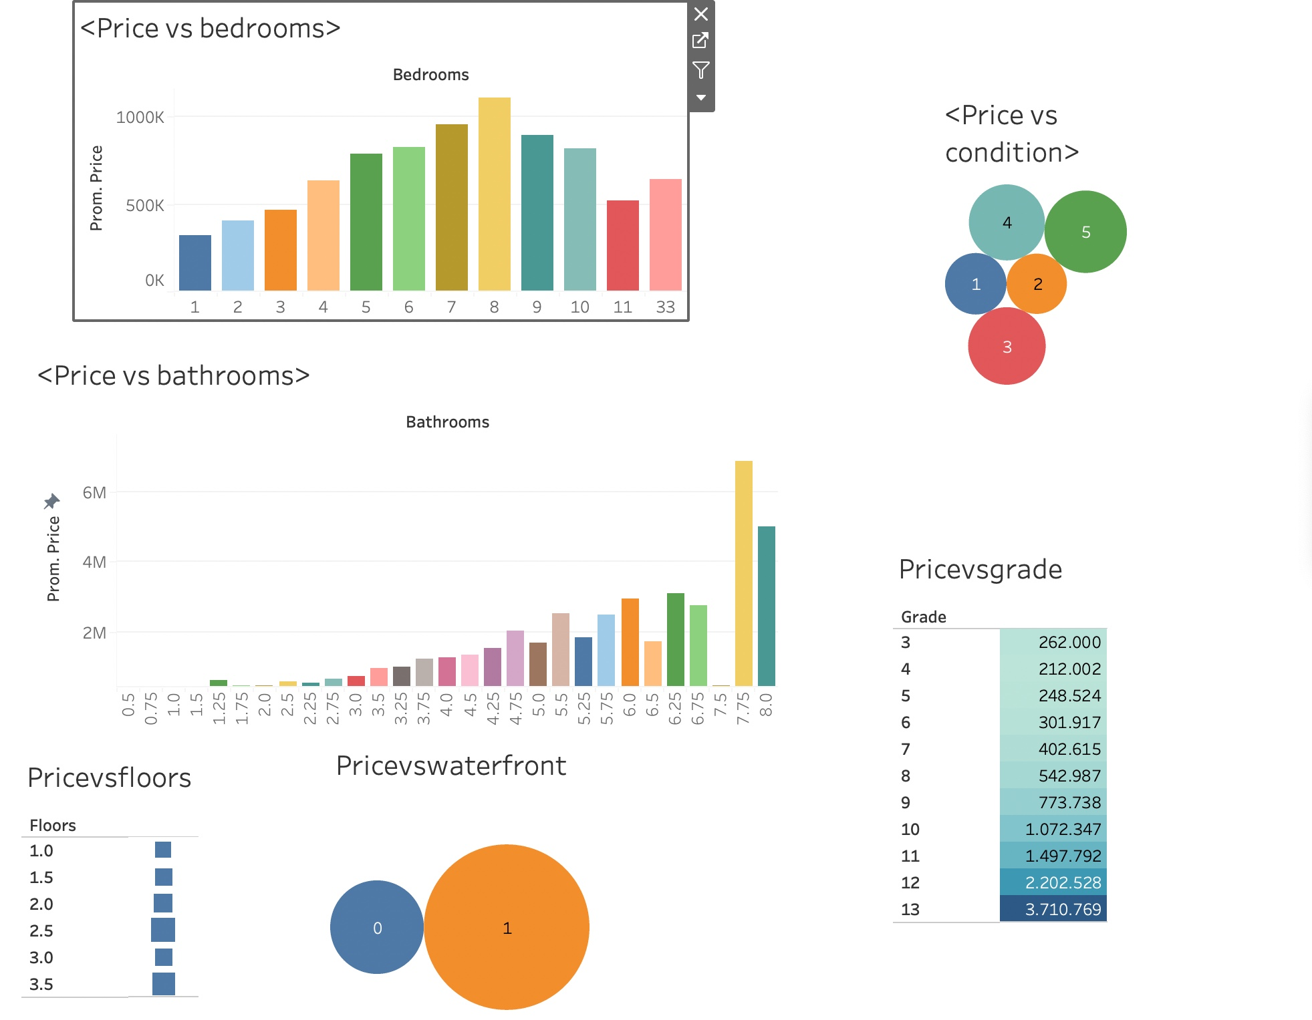

Slide 5
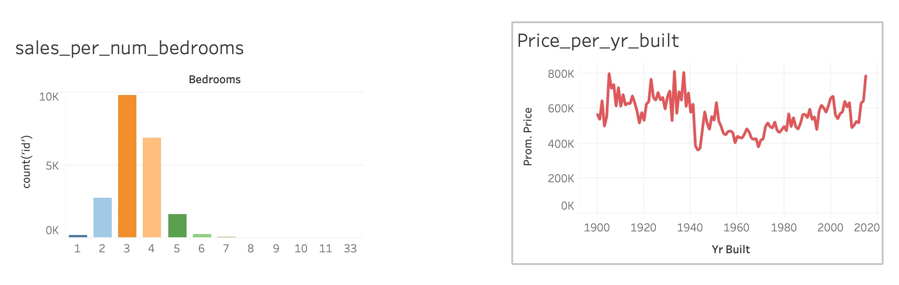

Slide 6
FEATURES MOST EXPENSIVE PROPERTIES
7-8 BEDROOMS
4-5 CONDITION
12-13 GRADE
2,5-3,5 FLOORS
GREATER NUMBER OF BATHS
PROPERTIES BUILT IN LAST YEARS
PROPERTIES WITH 3-4 BEDROOMS ARE THE MOST DEMANDED

Slide 7
CONCLUSIONS
LARGEST PROPERTIES GIVE US HIGHER PROFIT
PROPERTIES WITH MEDIUM SIZE (3-4 BEDROOMS) ARE BETTER TO SELL
SMALLEST PROPERTIES ARE NOT PROFITABLE
INVEST IN A FEW LARGE PROPERTIES
INVEST HEAVY IN MID-SIZE

Slide 8


Slide 9
ANALYSE DATA
LEN (21596)
INFO( NUMERICALES EXCEPT THE DATE)
DESCRIBE (COUNT, MEAN, STD…)
CHECK NAN VALUES (NON NAN VALUES)

Slide 10
CLEANING DATA
CREATE NEW COL RENOVATED INSTEAD YR_RENOVATED
DROP COLS: DATE, LONGITUDE, LATITUDE
CHANGE TYPE OF COL ZIPCODE AS AN OBJECT
CREATE THREE DATAFRAMES (DISCRETE, CONTINUOUS AND CATEGORICAL)
REMOVE OUTLIERS (BEDROOMS, BATHROOMS, SQFT_BASEMENT, CONDITION)
NEW LEN: 21.494

Slide 11
Comparing the Model
Linear regresión
KNeighborsRegressor
R2 = 0.65
RMSE = 207918.86 MSE= 43230252705.07 MAE = 136525.68
R2 = 0.52
R2 adjusted = 0.51 RMSE = 244682.52 MSE = 59869536257.77 MAE = 152514.59

Slide 12
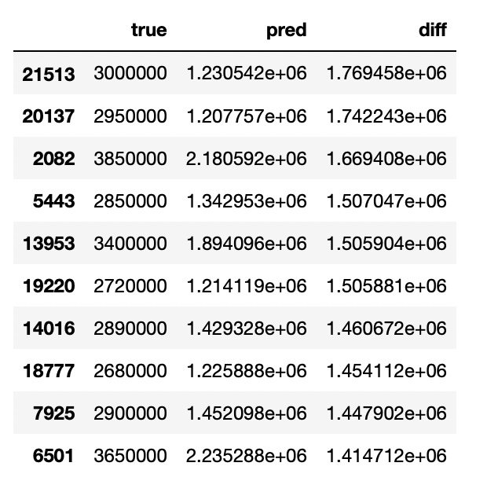
Linear regresion model

Slide 13
CONCLUSIONS
SELL RIGHT NOW SOME PROPERTIES
WAIT FOR INVEST IN NEW PROPERTIES BECAUSE NOW MARKET IS HIGH

Slide 14
THANK YOU

